Slide 1
REDUNDANCY REDUCTION IN FACE RECOGNITION USING SSD
FIRST REVIEW
Guided By,
Mr.M.Vignesh,
Assistant Professor,
Department of Artificial Intelligence and Data Science,
Karpagam Institute of Technology,
Coimbatore.
Presented by
S.DHANUSH(721220243010)
V.KISHOR KUMAR(721220243027)
S.LINKEDH (721220243028)
S.VIMAL(721220243062)
Department of Artificial Intelligence and Data Science,
Karpagam Institute of Technology,
Coimbatore.

Slide 2
OUTLINE
Abstract
Scope of Project
Introduction
Existing System
Proposed System
Module Identification
Data Flow Diagram and module description for all modules
References

Slide 3
ABSTRACT
The Proposed system improved Viola-Jones face detection using Single Shot Detector Algorithm in order to reduce the redundancy rates. Viola-Jones ' s algorithm has succeeded in determining the best face scale factor, but it produces a non-comparable face window that leads the redundant face detection.
Facial recognition uses Computer-generated filters to transform face images into numerical expressions that can be compared to determine their similarity.
Single Shot Detection algorithm significantly faster in speed and high-accuracy object detection algorithm. It exibits small convolutional filters to predict object classes and offsets to default boundary boxes.

Slide 4
SCOPE OF THE PROJECT
Though there are some weaknesses of facial recognition system, there is a tremendous scope in India.
This system can be effectively used in ATM's ,identifying duplicate voters, passport and visa verification, driving license verification, in defense, competitive and other exams, in governments and private sectors.

Slide 5
INTRODUCTION (REDUNDANCY REDUCTION IN FACE RECOGNITION USING SSD )
Facial recognition uses Computer-generated filters to transform face images into numerical expressions that can be compared to determine their similarity.
Human face recognition systems use unique mathematical patterns to store biometric data.
Most Detection Algorithm uses the Haar Features to Detect the Face and Objects.

Slide 6
EXISTING SYSTEM(LIMITATIONS)
Detection Rate
Training Time
Redundancy in Face Detection

Slide 7
PROPOSED WORK
The combination of Single Shot Detection and Viola – Jones algorithm to efficiently detect various parts of the human faces.
SSD is significantly faster in speed and high-accuracy object detection algorithm.
There are Three Basic methods used by Viola-Jones method which is as follows:
Haar-like features, Ada Boost, Cascade classifier
ADVANTAGES
High Detection rate
Low Training Time
Improved Accuracy
Optimized to Consume Low Memory and Response Time

Slide 8
MODULE IDENTIFIED
The Face Detector
(Module 1)
Data Scraping
(Module 2)
The Recognizer
(Module 3)

Slide 9
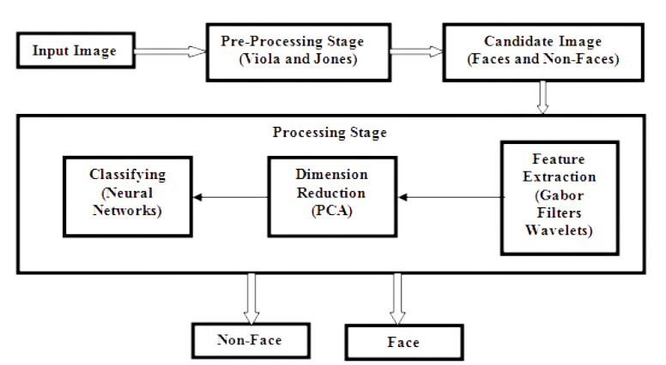
DFD FOR THE FACE DETECTOR

Slide 10
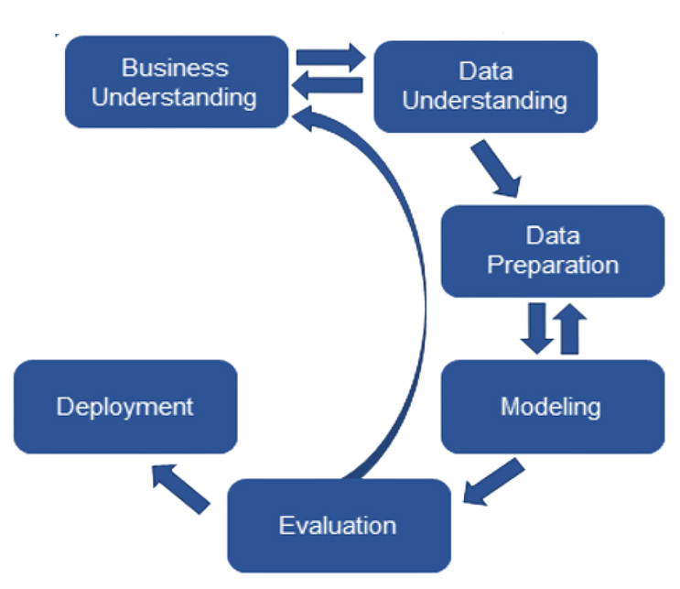
DFD FOR DATA SCRAPING

Slide 11
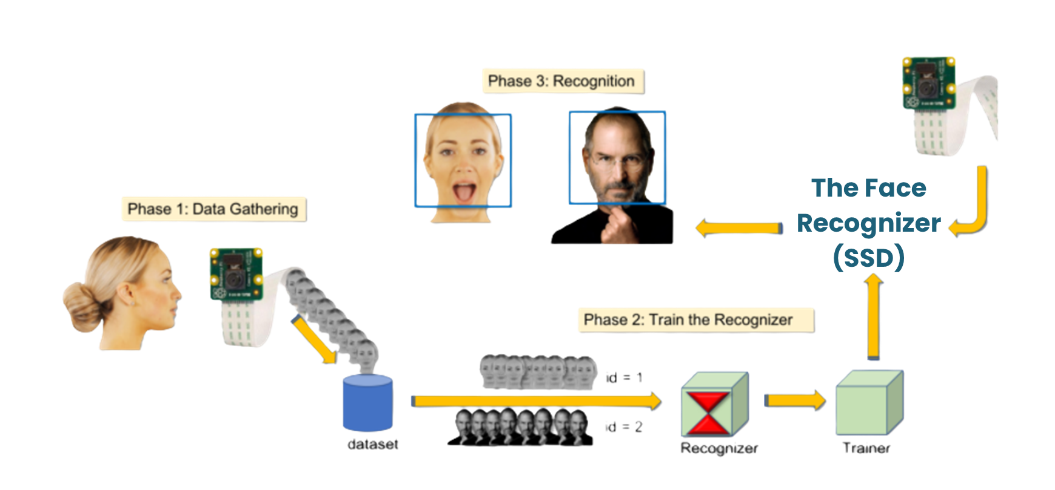
DFD FOR THE RECOGNIZER

Slide 12
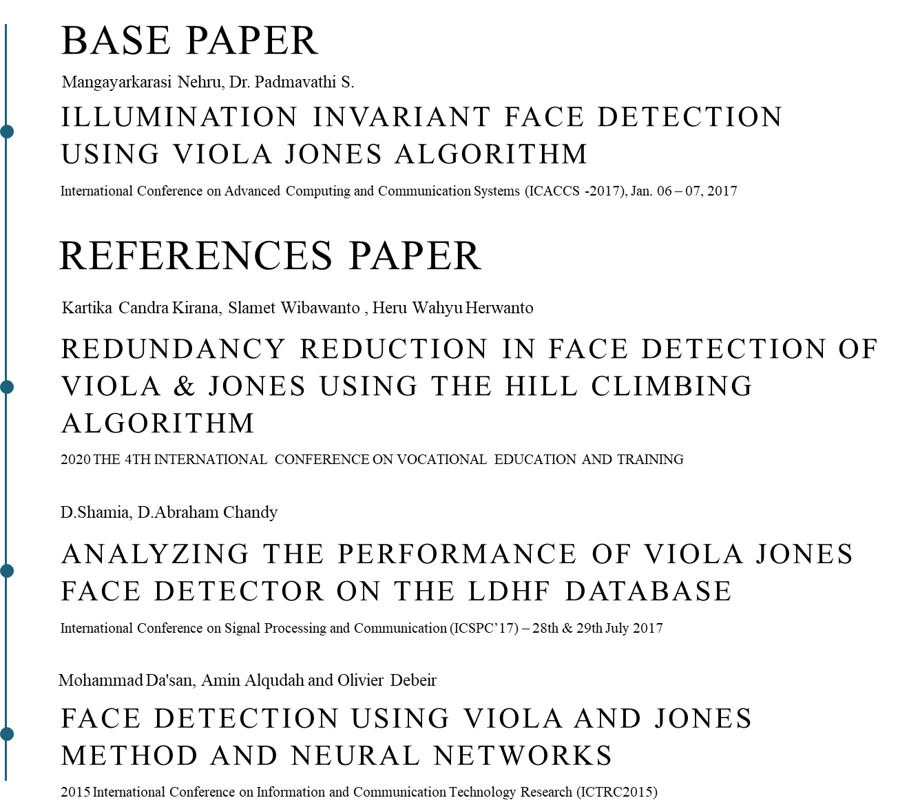
REFERENCES

Slide 13
Thank You!

